Slide 1
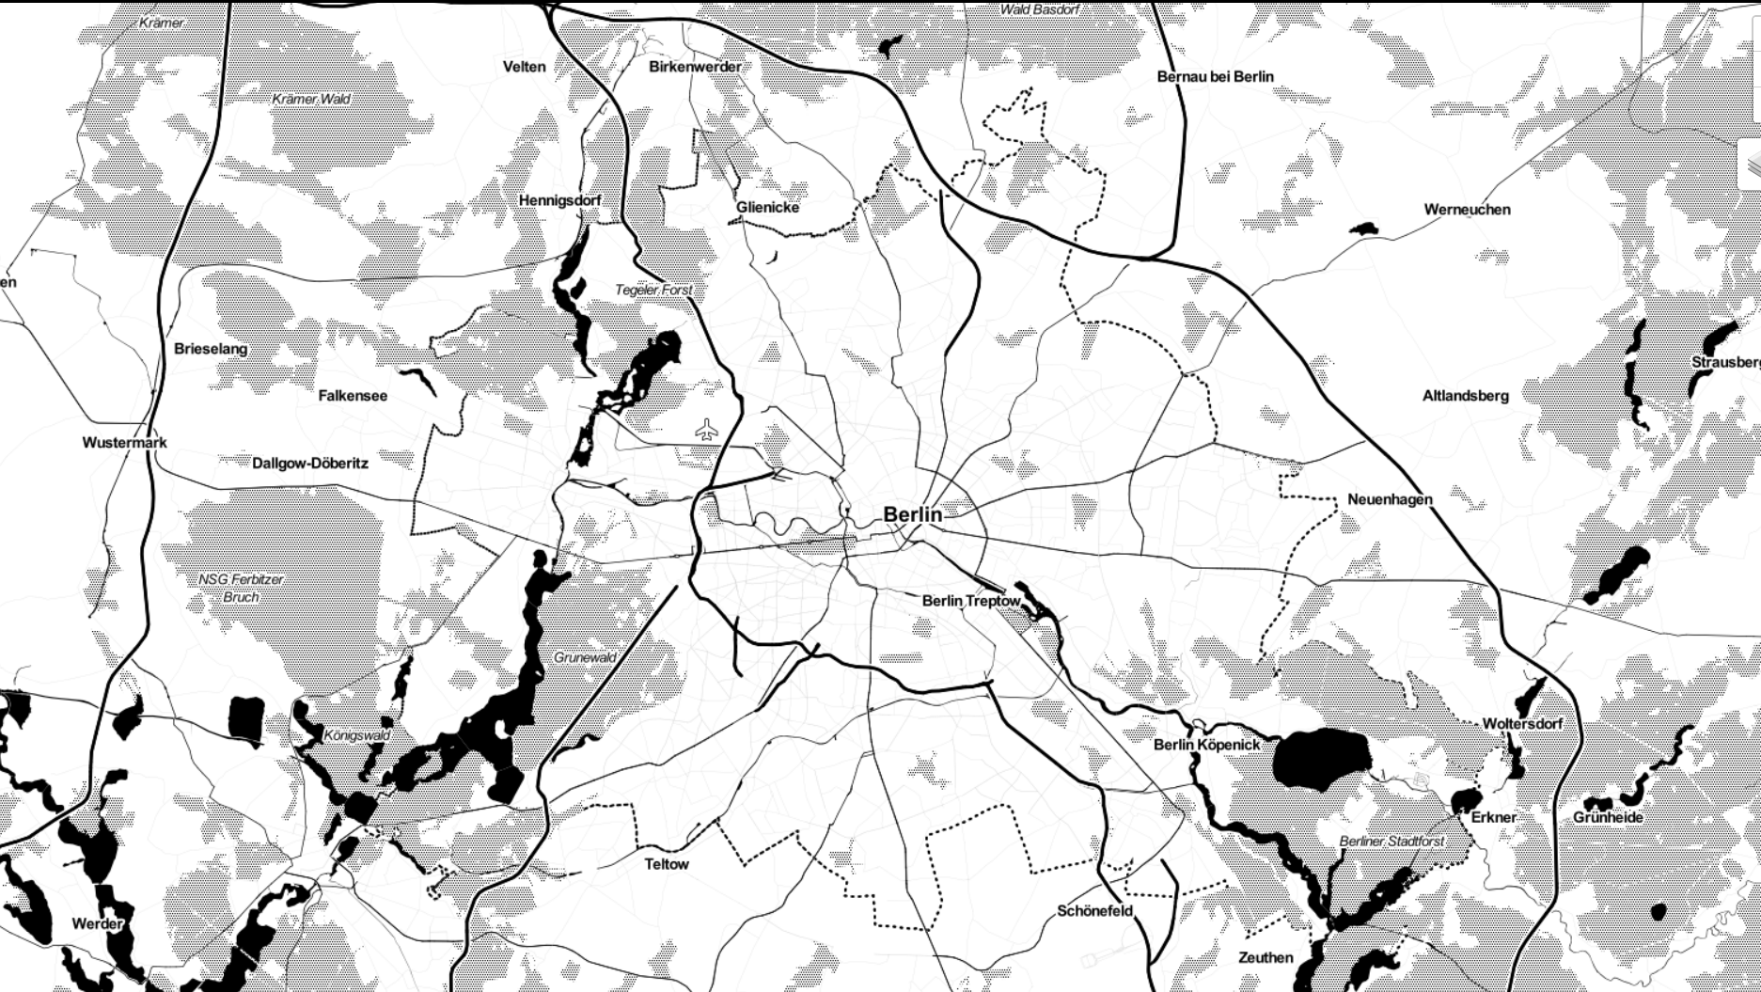
Berlin Traffic AccidentS
Interactive
Visualization
Exploring the Dangers of Berlin
Paul Kollhof
07.10.2022 – Berlin

Slide 2
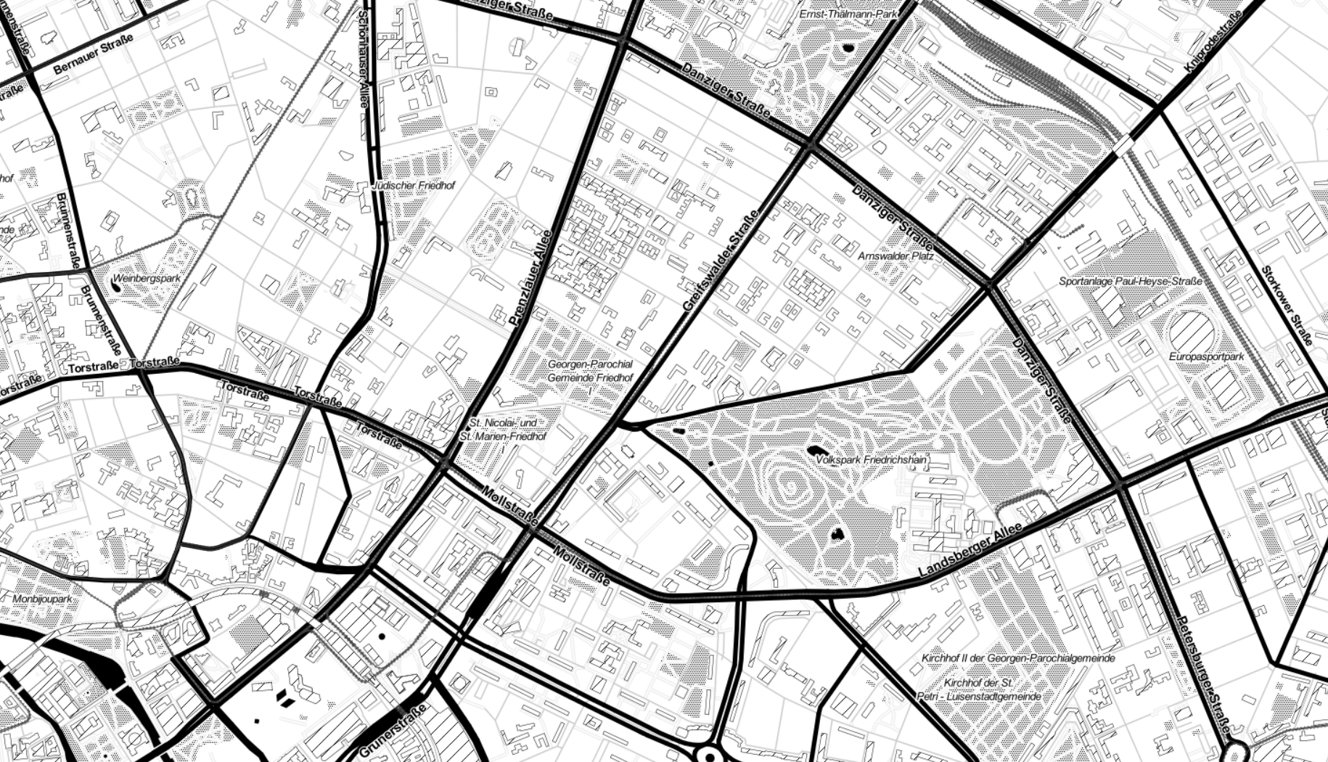

Data
OpenDataBerlin (www.daten.berlin.de)
Traffic accident data from 2018-2021
Registry of ~ 50.000 traffic accidents
Visualization
Geopandas, Folium
OpenSreetMap API

Slide 3
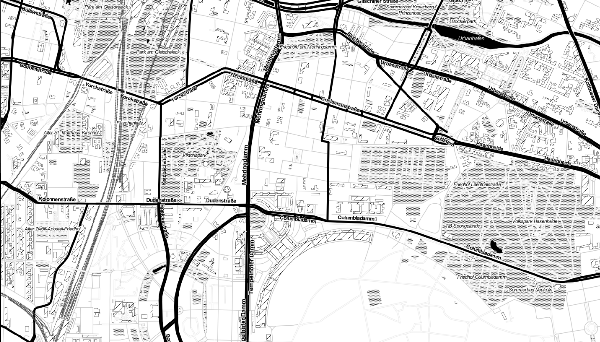

Who cares
Loves data, stats and numbers
Wants to explore Berlin by bike
Needs to know where and in what way it is dangerous

Slide 4
Let‘s go live

Slide 5
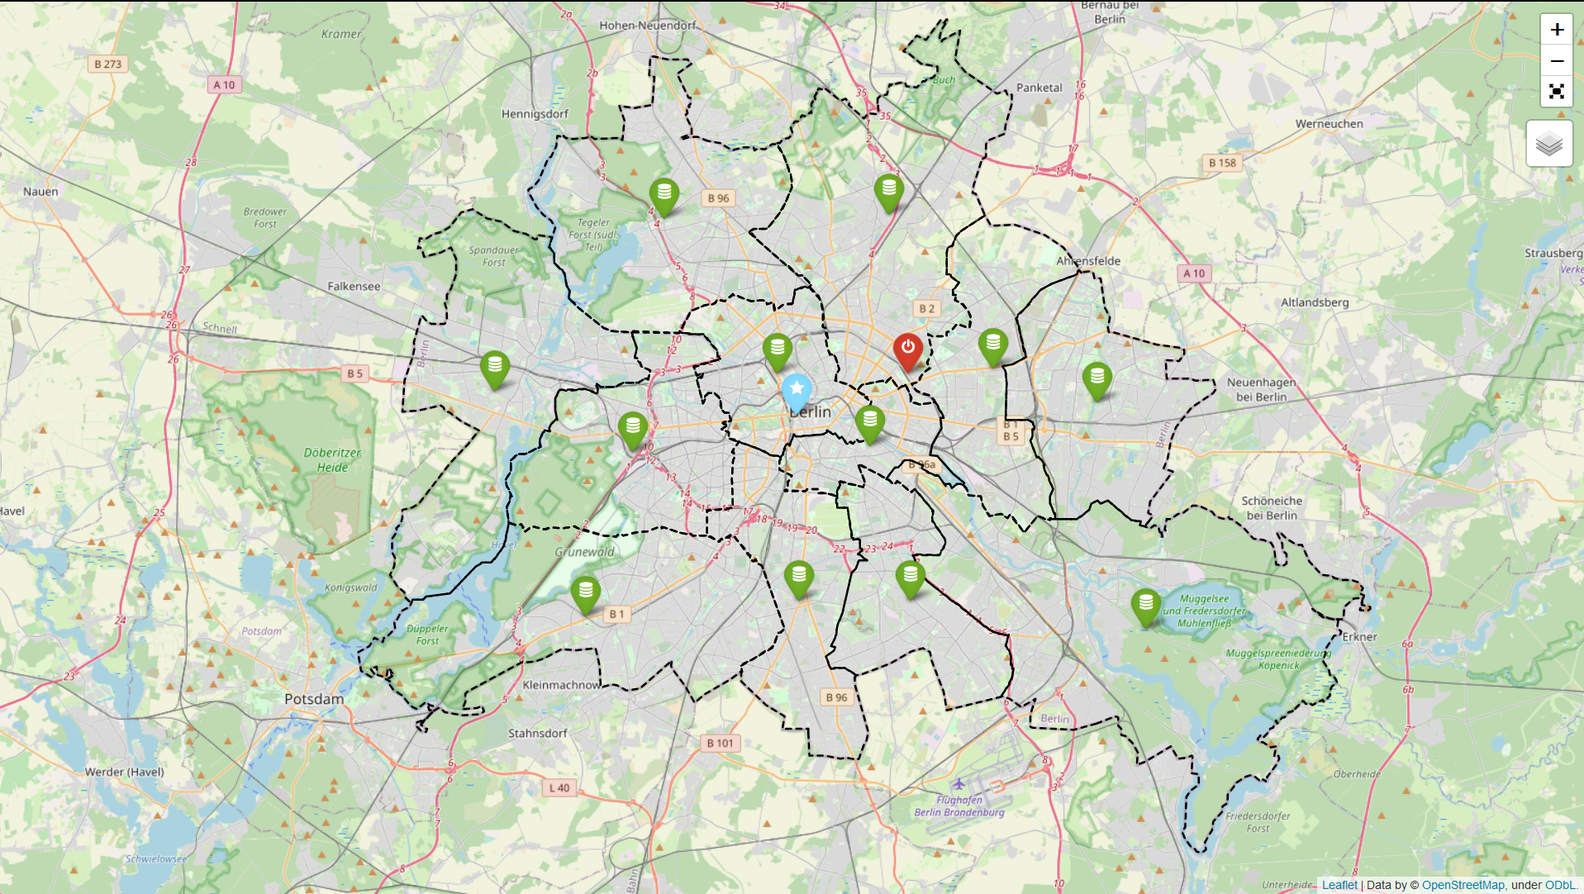

Slide 6
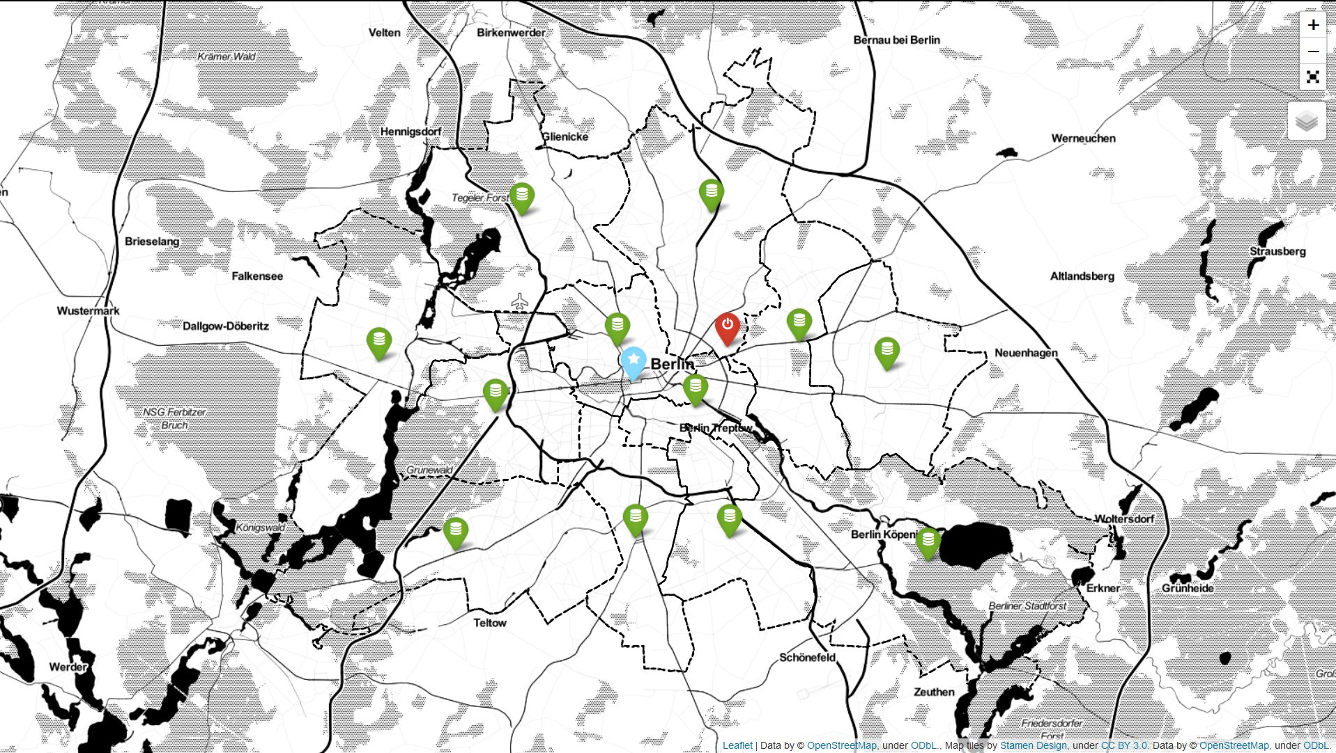

Slide 7



Data-Markers
District stats
City stats
Ironhack

Slide 8
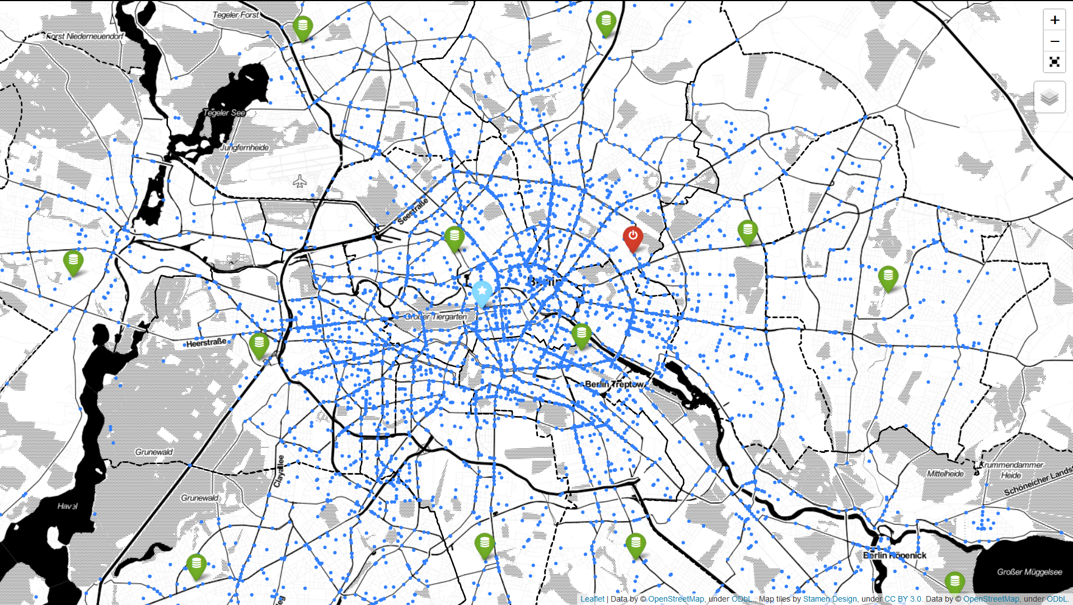

Slide 9
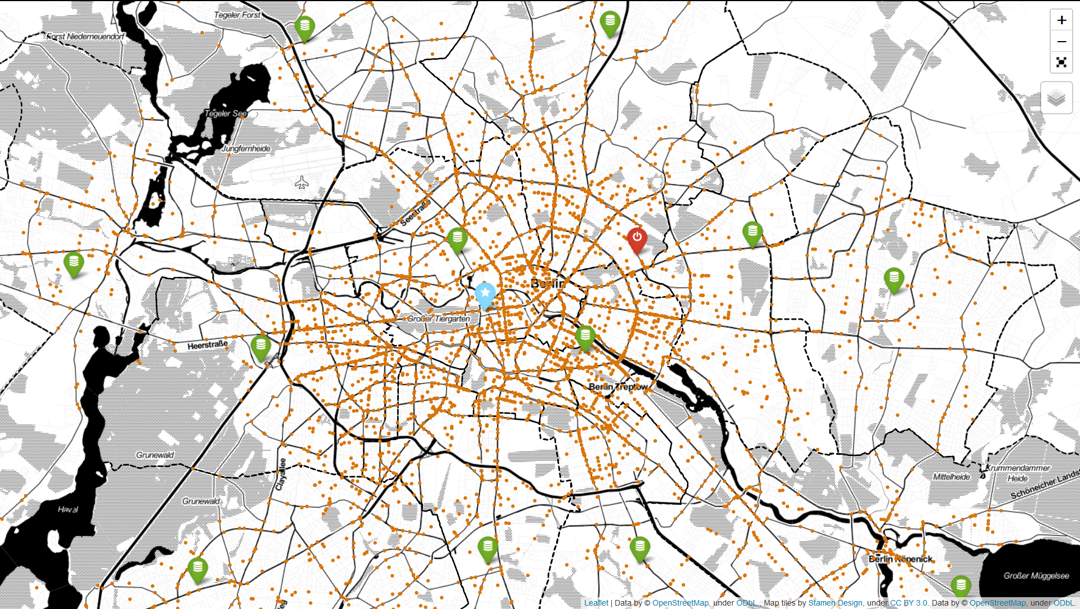

Slide 10
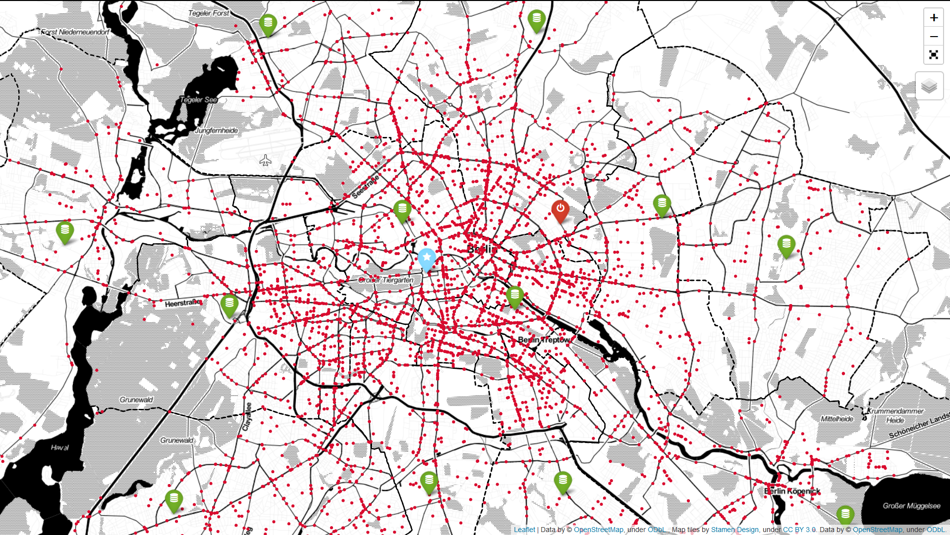

Slide 11
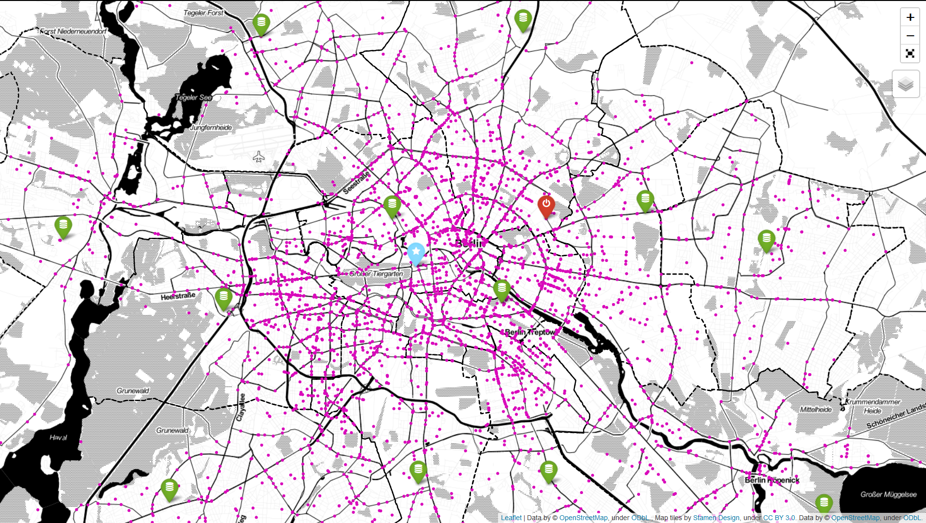

Slide 12
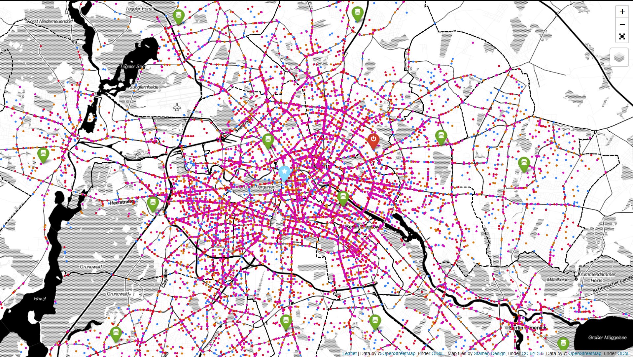

Slide 13
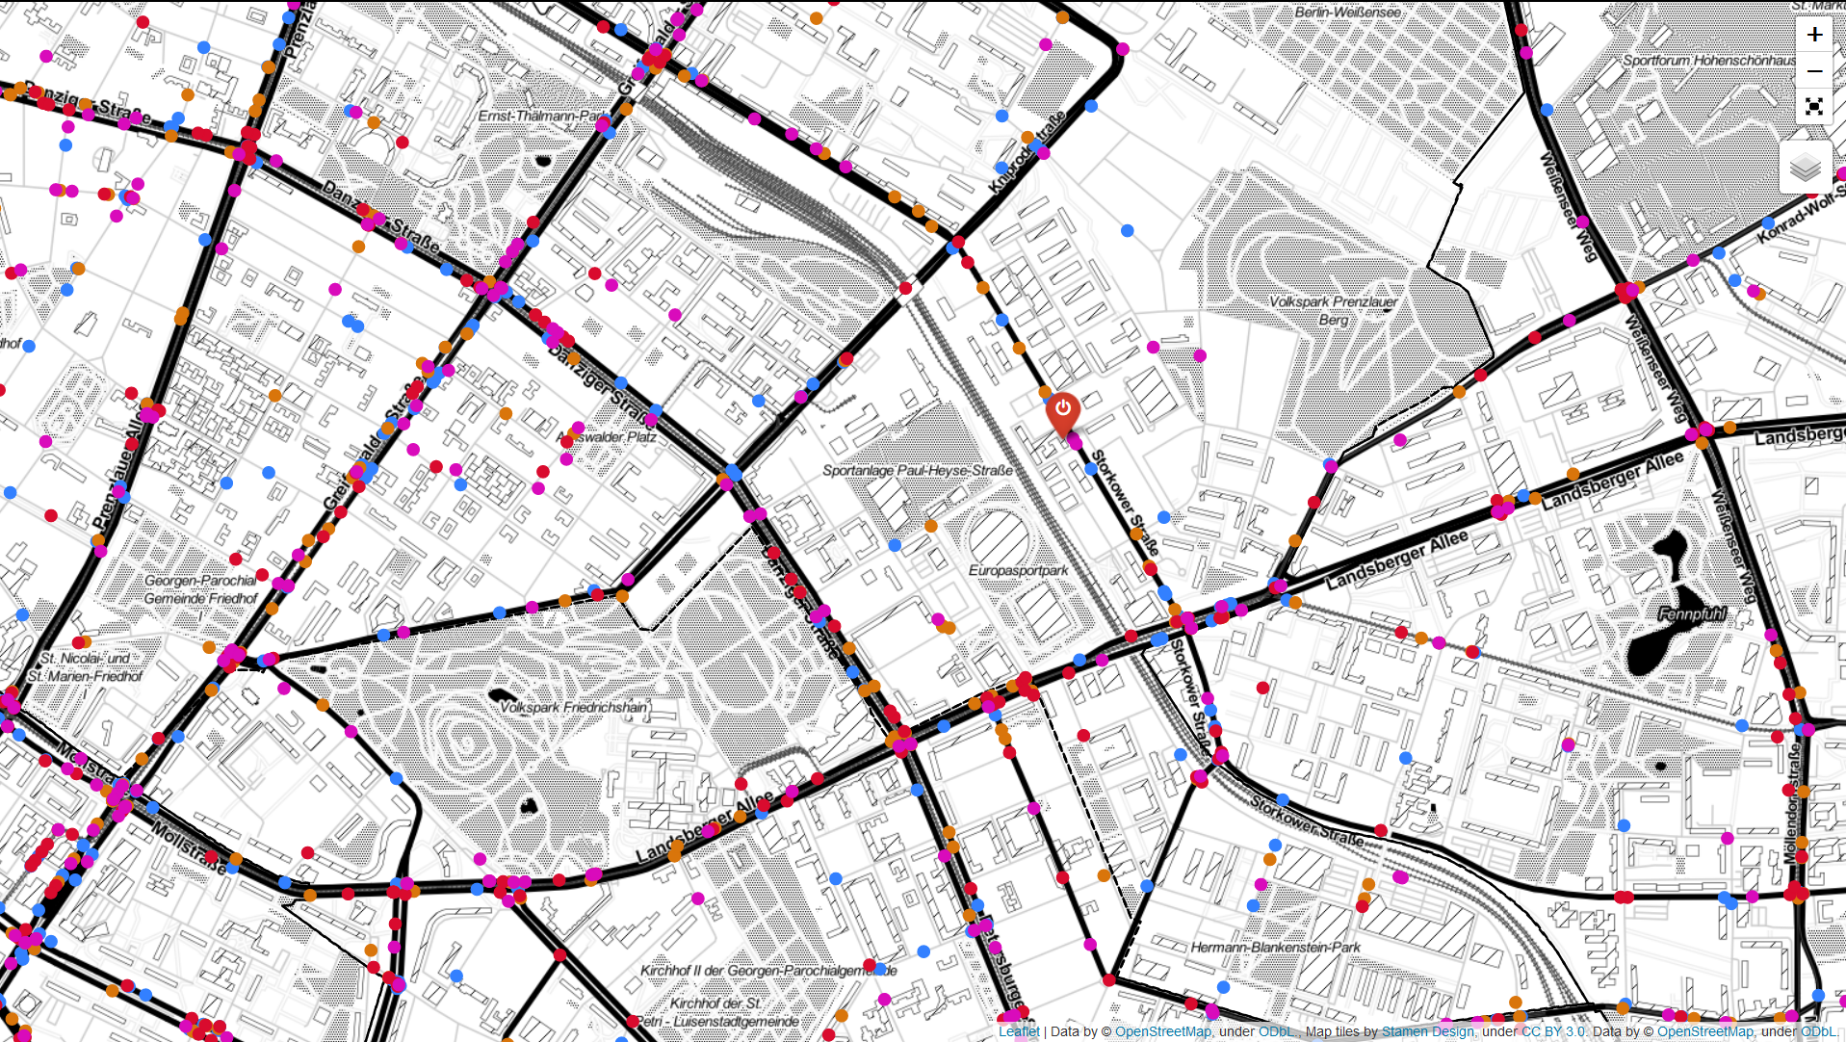

Slide 15
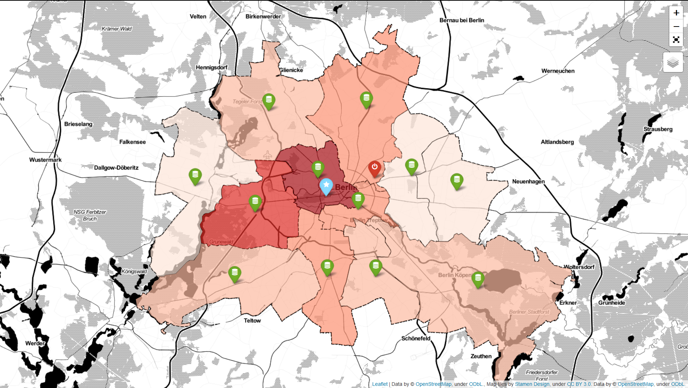
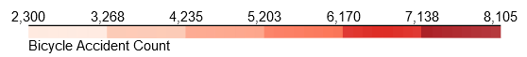

Slide 16
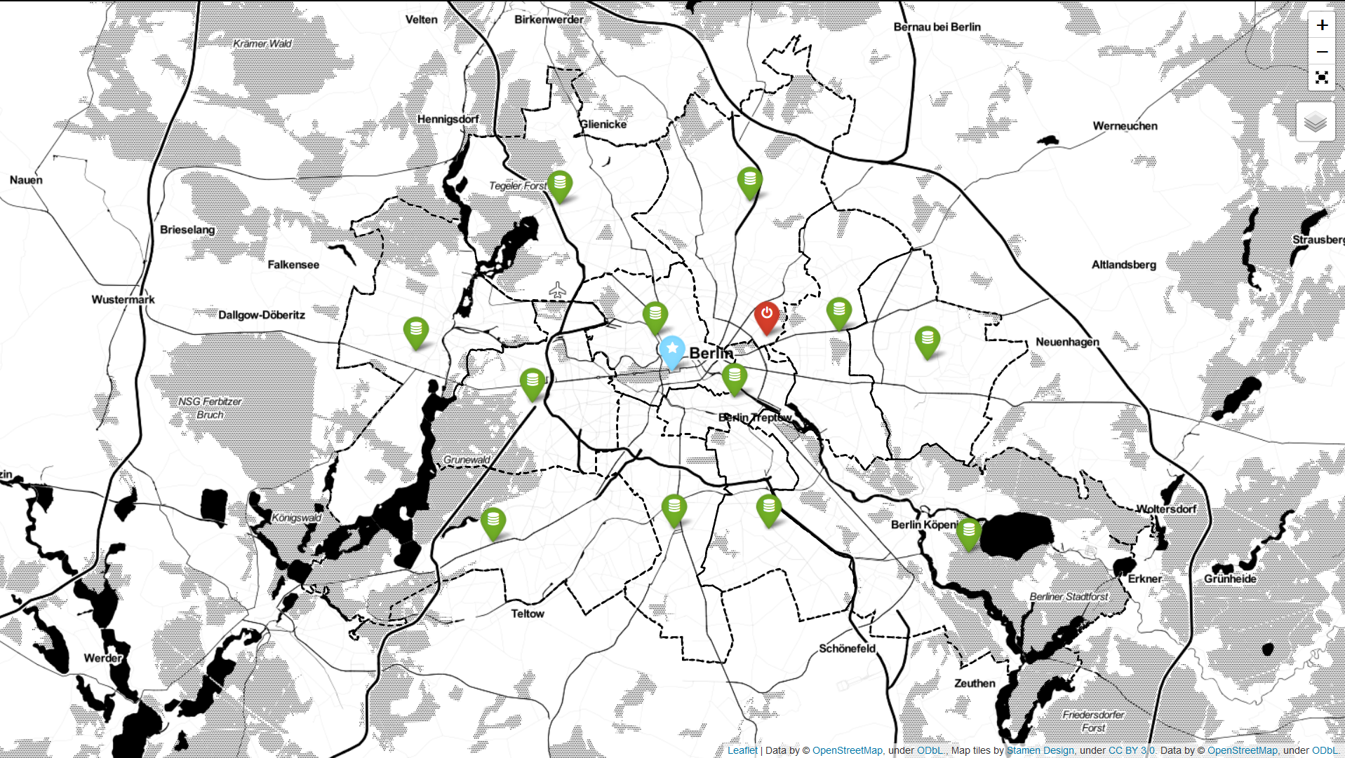
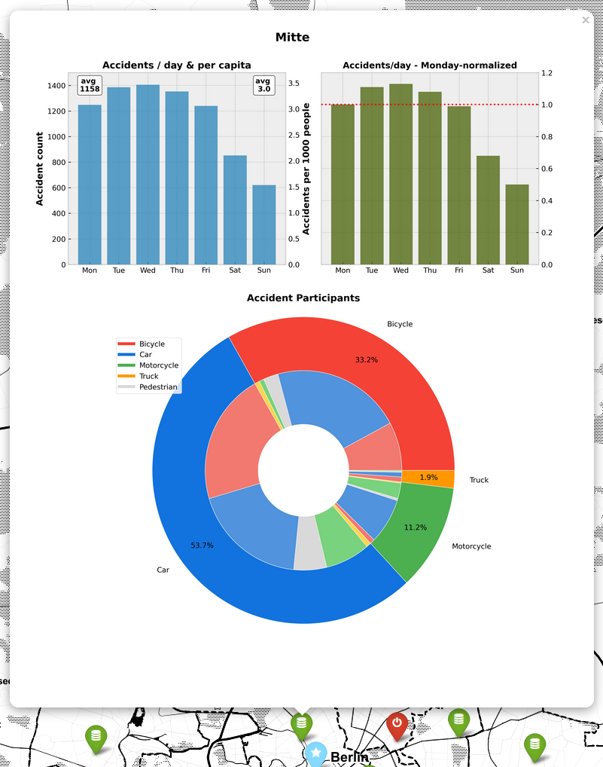

Slide 17
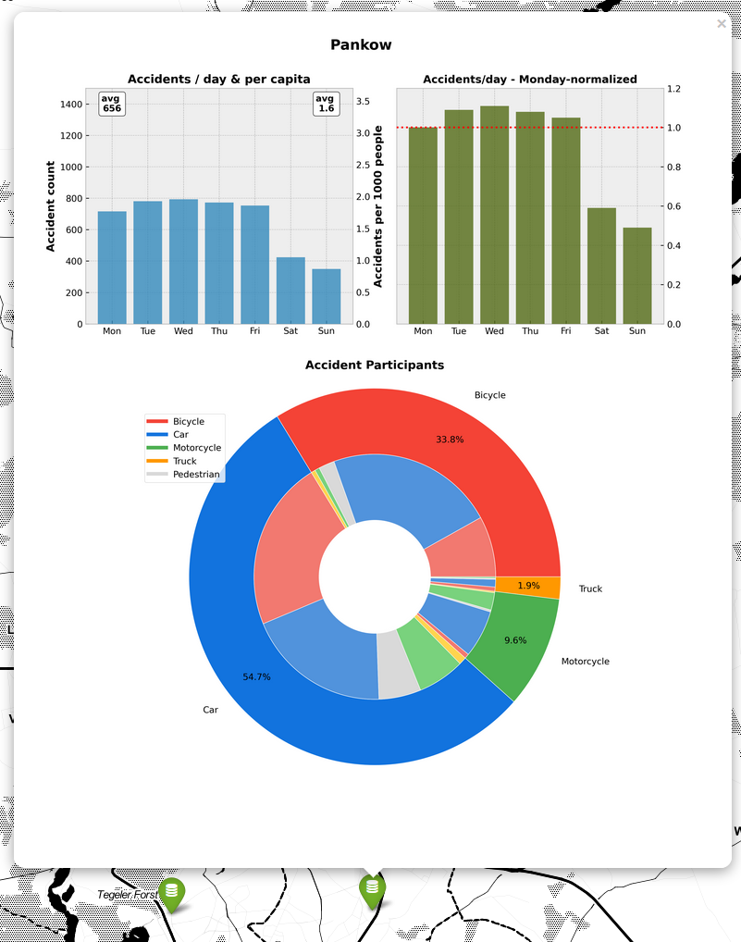

Slide 18
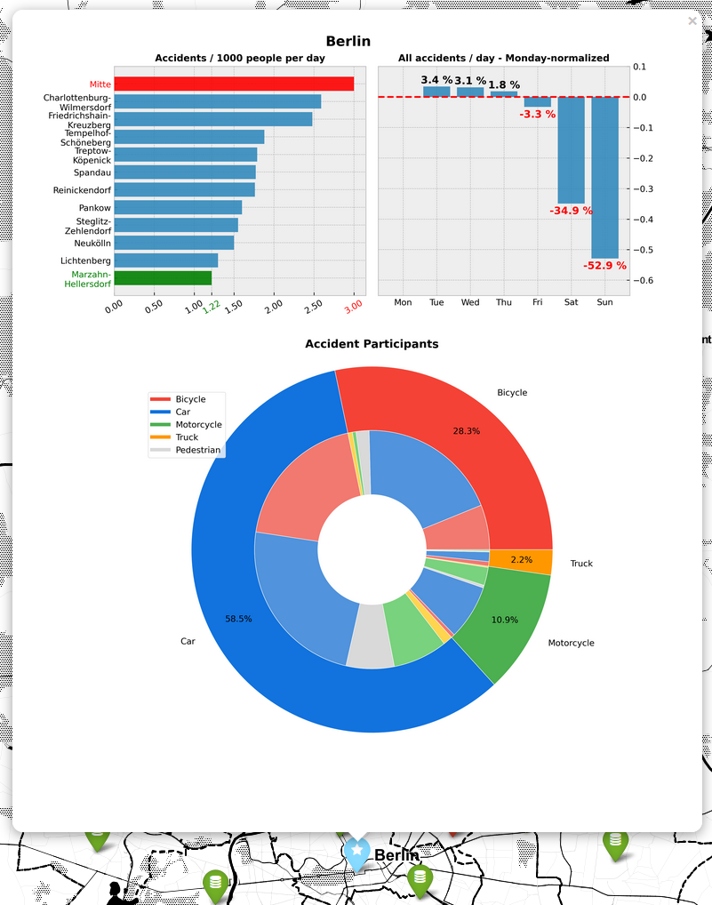

Slide 19
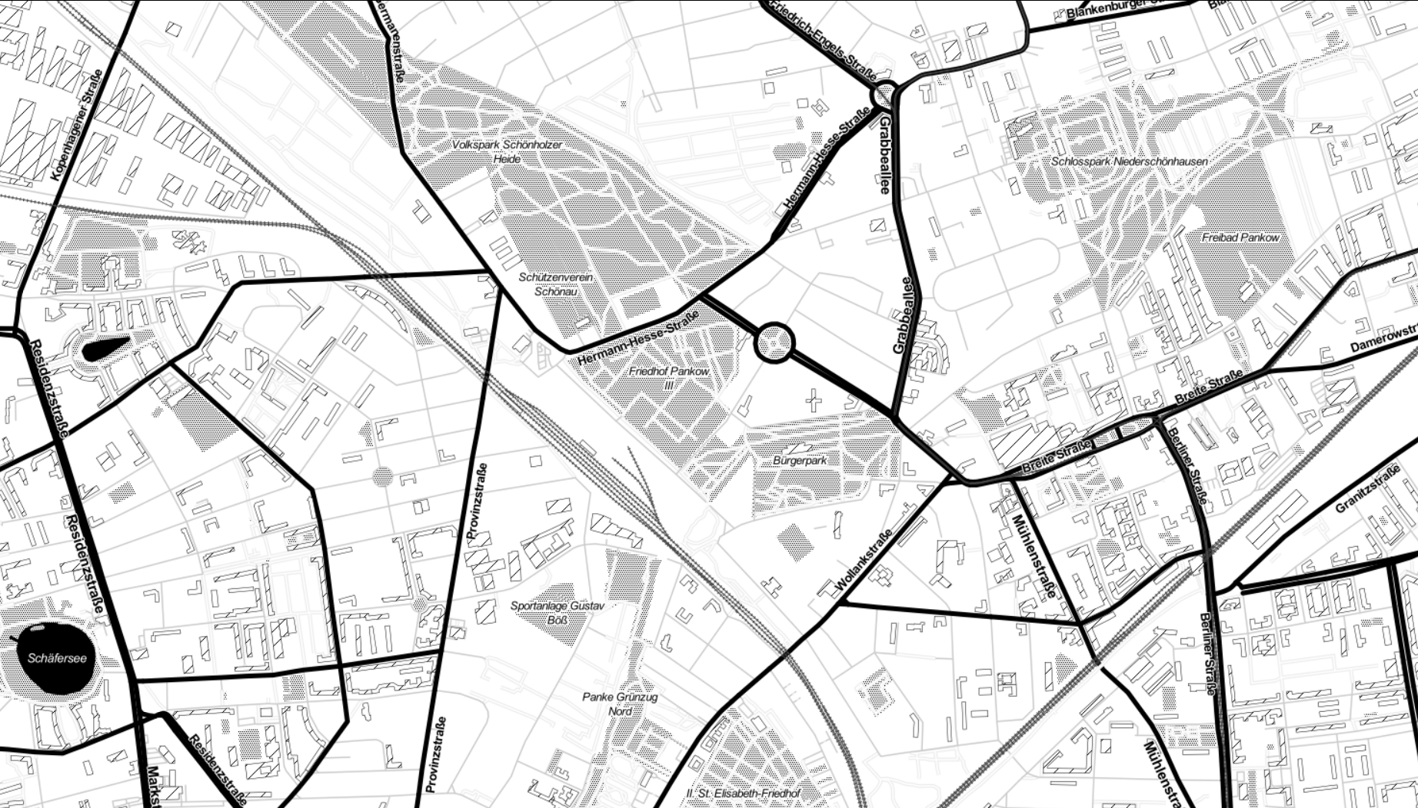
Outlook
Accident-avoidant routing
Display accident details
Predict potential acci-dent severity

Slide 20

Berlin Traffic AccidentS
Paul Kollhof
Interactive
Visualization
THANK
YOU

